Slide 1
IoT design and its applications
Beiyu Lin
Notes:
Hi Everyone, thank you for coming. I appreciate your time. Hopefully we will learn from each other today.
I am Beiyu Lin and today, I am going to talk about IoT design and tis applications.

Slide 2
Education background
2016-2020 | Computer Science | Washington State University | Pullman, WA, USA
2013-2015 | Math | Washington State University | Pullman, WA, USA
2011-2013 | Applied Math | Stony Brook University | Stony Brook, NY, USA
2007-2011 | Math and Applied Math | Shanghai Maritime University | Shanghai, China

Slide 3
Teaching and Research Experience
Spring 21 | Instructor | Computer Science I (C++), UTRGV (online)
Spring 21 | Instructor | Computational Behavior Modeling, UTRGV (online)
Fall 20 | Instructor | Computer Science I (C++), UTRGV (45 undergraduates; online) | eval: 4.51/5
Fall 20 | Instructor | Seminar in Computer Science, UTRGV (27 graduates; online) | eval: 4.48/5
08/2020 - now | Assistant Professor | University of Texas RGV | Edinburg, TX, USA
2015 - 2020 | Graduate Research Assistant | Washington State University | Pullman, WA, USA

Slide 4

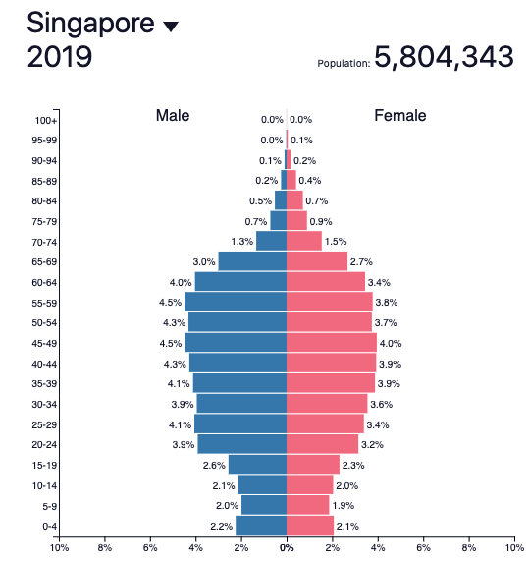
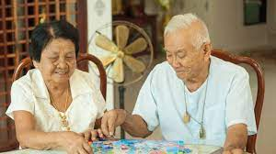
Research Goal
Notes:
In 2019, 14 percent of the population in Singapore will be aged 65 and older. In 2030, it will be 25 percent.
(point to the graph) As we can see the senior populations are increasing, we anticipate that there will be increasing healthcare needs of seniors both for their physical and mental health problems. We want to design technology to help them live independently at home as long as possible and provide them a positive quality of life.
One way is to understand routine behavior patterns and their behavior changes in smart environment.
With decades of behavior data over 100 SHs => We now can construct computational Models to analyze behavior both at a population level + subgroups

Slide 5

Research Goal
Many applications such as healthcare, social networks, urban
mobility, e-commence…
Daily Routines
Automate Diagnoses
Sociology/Psychology/
Anthropology
Notes:
Once differences in patterns are discovered, they can be used to better understand the impact of personal characteristics, such as age, health conditions, and education on daily routines.
They can also be used to automate diagnoses and predict additional behavioral features of individuals within a group.
The results will also help researchers in the fields of sociology, psychology, and anthropology to align their theories more closely with actual human behavior.

Slide 6
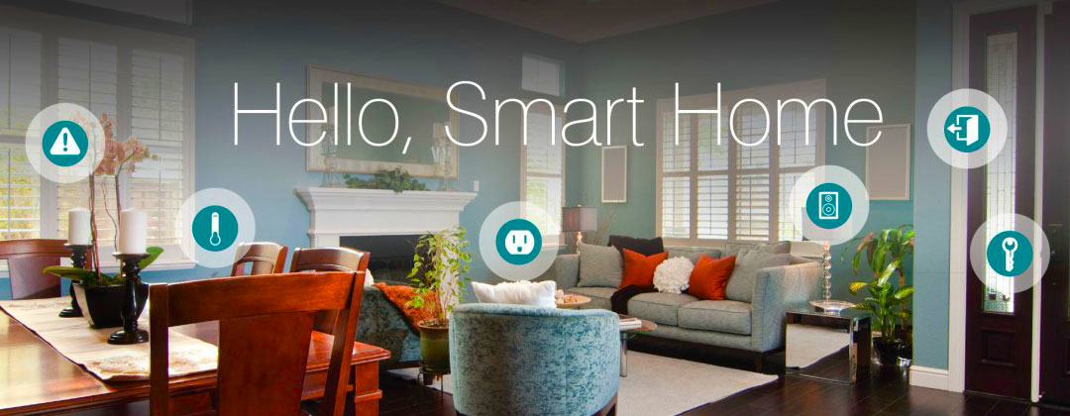
Topic Steps
Computational Challenges
in Sensor Data
Mathematic Model
of Behavior
Inverse Reinforcement Learning
Model of Behavior
Notes:
In this thesis, I developed efficient algorithms that utilize stochastic approaches and machine learning methods to express the nature of the observed behavior in smart homes.
1. we construct Mathematical model of indoor behavior by analyzing one temporal feature. The resulting mathematical model openS up the possibility of understanding the general principles behind human behavior.
2. focus on based on spatial and temporal features that extracted from smart home sensor data.
allows to us to investigate the complex dependencies of activities.
3. third, employ an IRL method to model indoor navigation and its behavior patterns by fuse two types of
features into one model.
When data are combined from multiple sources, a challenge arises in creating a model that can include all available information. The IRL method helps us construct a model that combines resident temporal and spatial information and also help us learn behavior preferences among population groups.
Note:
Each of these offers a different modeling benefit
???

Slide 7
Contributions
Indoor behavior can be modeled by a Pareto distribution
Innovation: heavy-tailed distribution (Pareto distribution)
Impact: the Pareto distribution and its properties, the 80/20 rule, can be used to model various human behavior patterns
2. Proposed a new measure for model selection
Innovation: a new measure to balance the tradeoff between under/over-estimating the true Markov order
Impact: understand the complexity of sensor-observed human indoor behavior
3. Proposed inverse reinforcement learning to learn indoor behavior
Innovation: 1st study of IRL to model indoor behavior
Impact: extract quantitative and qualitative measures of human behavior
4. Distinguished population subgroups based on ambient sensor data
Innovation: population-level behavior analysis via ambient sensor data
Impact: compare behavior for healthy older adults with behavior of older adults with chronic health conditions

Slide 8
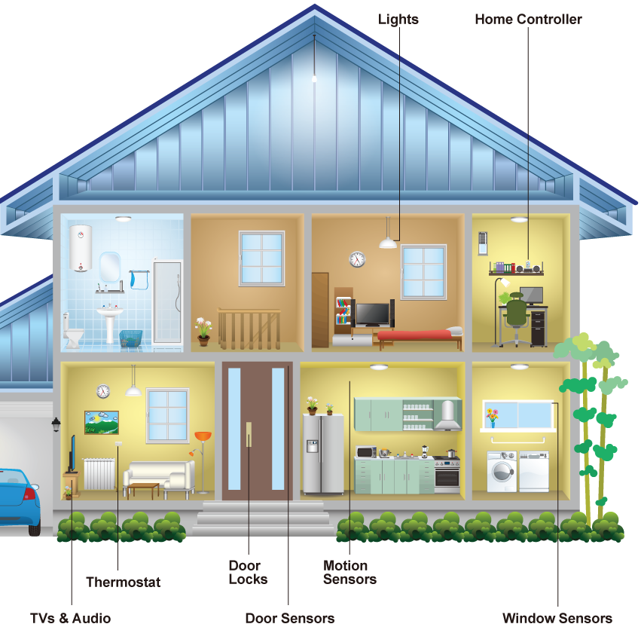
Sensor Data
Sensor types: infrared motion(narrow/wide-area), ambient light, magnetic, and temperature sensors.
2011-06-13 | 21:48:43 | Bathroom | ON | Personal_Hygiene
2011-06-13 | 21:48:44 | Bathroom | OFF | Personal_Hygiene
2011-06-13 | 22:47:02 | Bedroom | ON | Personal_Hygiene
2011-06-13 | 22:47:04 | Bedroom | OFF | Sleep
2011-06-13 | 22:47:06 | Bedroom | ON | Sleep
………………
2011-06-14 | 10:11:24 | Kitchen | ON | Wash_Dishes
2011-06-14 | 10:11:25 | Kitchen | OFF | Wash_Dishes
2011-06-14 | 10:11:40 | Kitchen | ON | Cook
2011-06-14 | 10:11:41 | Kitchen | OFF | Wash_Dishes
imgbin.com
Notes:
Here is an examples of smart home and sensor data.
Our sensors includes infrared motion/ambient light sensors, magnetic doors/ windows, and temperature sensors. All of these are ambient sensors that are only updated if there is a significant change in a state, for example, a door opening or closing.
(point to the graph)
For the motion sensors, we have narrow-area and wide-area sensors. The Narrow-area motion sensors are placed on the ceilings above some specific items in the house, including above the stove, entryway, and dining chairs. This is because this kind of sensors can perceive motions that occur in a one-meter diameter area.
Wide-area motion sensors are installed on the ceiling in large rooms such as the kitchen, living rooms, and bedrooms, and have a much wider coverage so as to recognize motions happening anywhere in the room.
Magnetic sensors are used for external windows and doors, as well as for internal cabinets, and doors in bathrooms and living rooms.
Temperature sensors are placed in most of the rooms to both perceive key activities such as bathing and cooking, and to sense significant temperature changes at
those points in each room.
===========
Here is a sample of our SH sensor data. It includes timestamp, sensor location, sensor event (ON/OFF, OPEN/CLOSE), activities ( such as, cook, eat, sleep, personal hygiene).
Q: how many of you ran out of a building because of false fire alarm?
Similar to smoke detectors, smart home sensor may also send false information. That is, computational challenges exist in sensor data.

Slide 9
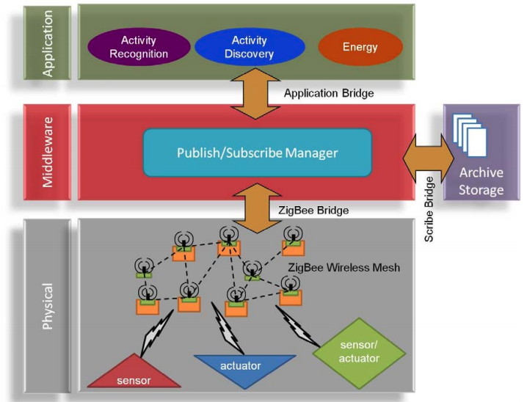
Software Architecture
Notes:
The SHiB architecture has three components: physical components, the middleware, and the software applications.
The physical components include sensors and actuators that use a Zigbee “bridge” to communicate with the middleware, which is controlled by a publish/subscribe manager.
The middleware is a process that adds the timestamp to sensor events and maintains sensor states. The middleware also uses a scribe bridge to store messages in a lasting archive, and an application bridge to share/exchange information with the applications.
The SHiB architecture is easily maintained and expanded because of its lightweight bridge design (via application programming interfaces).
During perception, control flows up from the physical components through the middleware to the software applications.
When taking an action, control moves down from the application layer to the physical components that automate the action.
Our goal is that each of the layers is lightweight, extensible and ready to use as is, without additional customization or training

Slide 10
Step 1
Computational Challenges
in Sensor Data
Notes:
In this thesis, I developed efficient algorithms that utilize stochastic approaches and machine learning methods to express the nature of the observed behavior in smart homes.
1. we construct Mathematical model of indoor behavior by analyzing one temporal feature. The resulting mathematical model opens up the possibility of understanding the general principles behind human behavior.
2. focus on based on spatial and temporal features that extracted from smart home sensor data.
allows to us to investigate the complex dependencies of activities.
3. third, employ an IRL method to model indoor navigation and its behavior patterns by fuse two types of
features into one model.
When data are combined from multiple sources, a challenge arises in creating a model that can include all available information. The IRL method helps us construct a model that combines resident temporal and spatial information and also help us learn behavior preferences among population groups.
Note:
Each of these offers a different modeling benefit
???

Slide 11

Sensor Data—Computational Challenges
Missing values |  | Sensor failures
Sensor jitters |  | Guest in the house
Processing features in real time… |  | Residents test sensors for fun…
Notes:
Sensor data are very noisy. It may be because of sensor failures, visitors in the home and so on.
computational challenges includes imputing missing value, cleaning sensor jitters, and processing features in real time from sensor data
Missing values: It can be expected that transmitted sensor data are lost or corrupted due to many reasons, such as power outage at the sensor's node, random occurrences of local interferences, or a higher bit error rate of the wireless radio transmissions as compared with wired communications.
Jitter: for example, given 10 minutes, it should be only have 1 event detected by the sensor. But due to …., it sends back 10 events.
To tackle these challenges, I have designed methods that have been applied to two multi-disciplinary research projects: Indoor Air Quality and Clinician In the Loop (CIL).
https://en.wikipedia.org/wiki/Jitter#Jitter_metrics
https://www.reddit.com/r/techsupportmacgyver/comments/9up1t3/my_office_conference_rooms_have_very_sensitive/

Slide 12
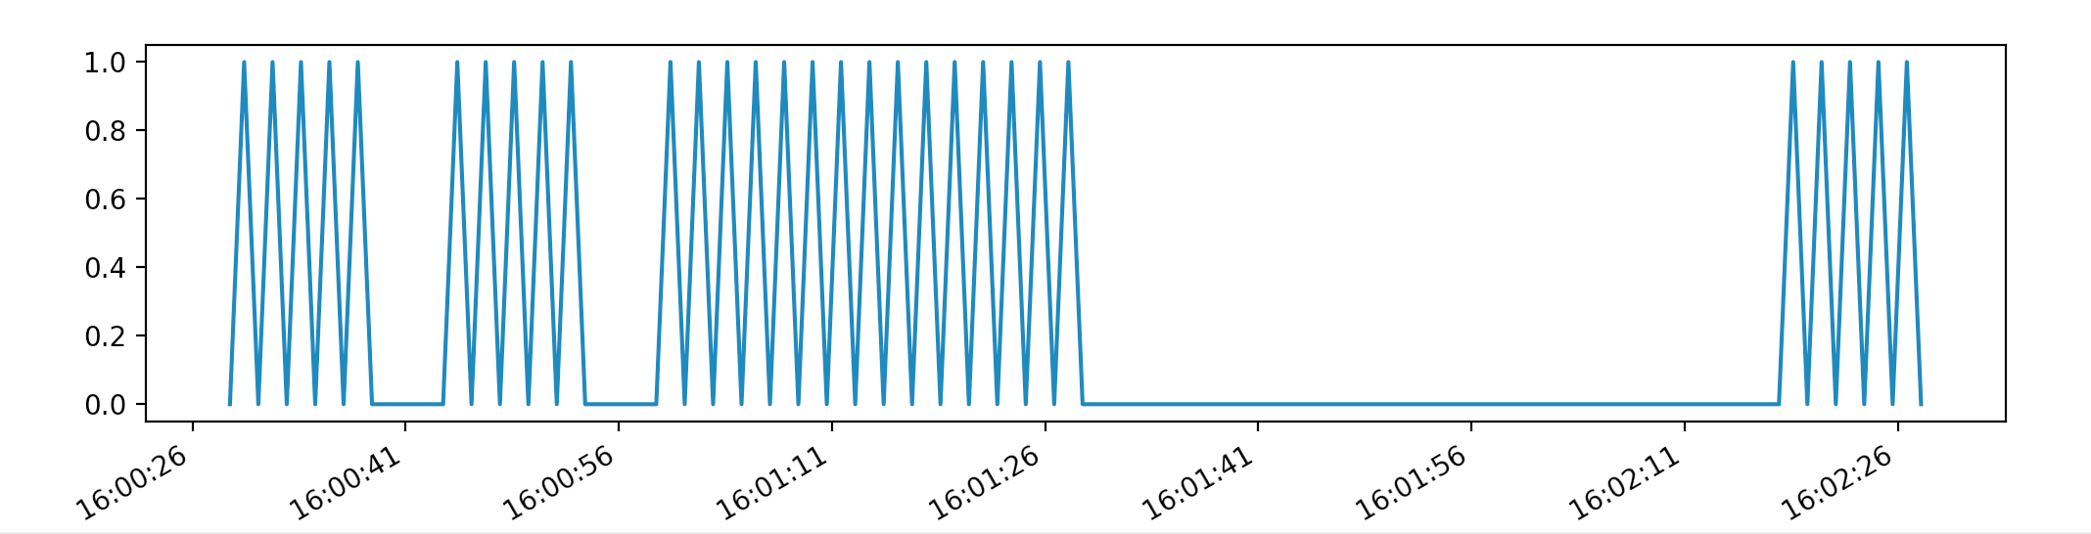
Sensor Data—Computational Challenges
Clean jitters
open
close
open
large gap
Notes:
Here, I show one algorithm to clean jitters. The algorithm automatically learns the next large gap. The interval before this large gap would be an interval with “open” at the beginning and “close” at the end.
Once we imputed the missing values and cleaned the jitters, we can handle the next computational challenge: processing features in real time from streaming data.
For different projects, the features are designed different for real time processing.

Slide 13

Application1 -- Indoor Air Quality
Global Population Growth
Global Aging Issues
Air Quality
Indoorbreathing.com
Notes:
For the Indoor Air Quality project, as we experience global population growth and global aging issues, there will be corresponding concerns about the quality of the air we experience inside and outside buildings. Because we can anticipate that there will be behavioral changes that accompany population growth and aging, we examine the relationship between home occupant behavior and indoor air quality. To do this, we collect both sensor-based behavior data and chemical indoor air quality measurements in smart home environments.
I created algorithms to discover residents’ behavior patterns exhibited in smart home sequential datasets.

Slide 14
Methodology -- Indoor Air Quality
Algorithms to discover residents’ behavior patterns
overall activity level; duration of activity
temperature; opening area of windows/doors
Machine learning-based approach to find the relationship
Overall Activity Level > 30
Yes
No
Opening area of bathroom door > 20
Temperature > 25 ˚C
Yes
No
Opening area of main door > 10
Opening Area of bathroom window > 5
…
…
Notes:
I identified four types of smart home features that are used to extract and correlate with chemical variables. These features include the overall activity level (based on sensed movement), the duration of each automatically labeled activity, temperature, and the opening area of windows and doors.
Further, I introduced a novel machine learning-based approach to quantify the correlation between smart home features and 52 chemical measurements of air quality.
For example, one ML algorithm, random forest, is used to find the relationship. The random forest is based on 100 random trees to get the average results. The reason is that the average results from random forest is more stable than that from one random trees.
Here is an example of a random tree…. (explain the graph).

Slide 15
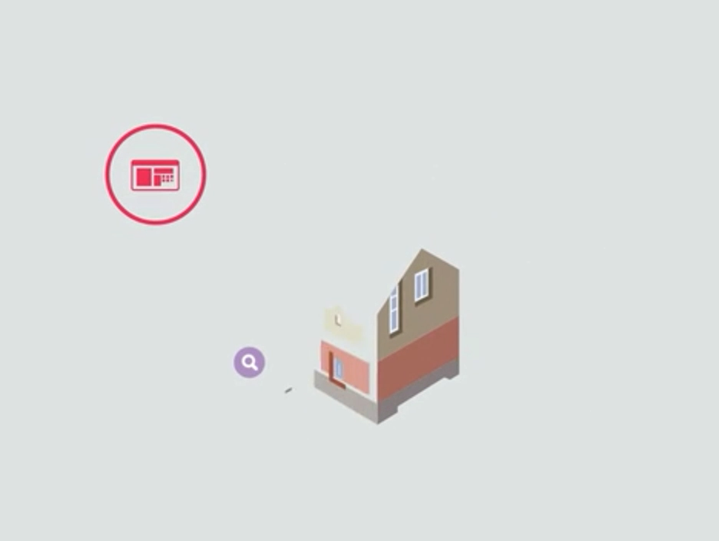
Impact --Indoor Air Quality
Understand the types of behavior
Aid decision-making processes for automated systems
Develop automated building systems in smart cities
Notes:
The findings may help us understand the types of behavior that measurably impact indoor air quality.
Further, the findings of these sequential data mining method have the potential of aiding various decision-making processes for automated systems. For example, decisions include when to open/close windows/doors and turn on/off home ventilation systems.
This information could help us plan the future by developing an automated building system that would be used as part of a smart city.

Slide 16
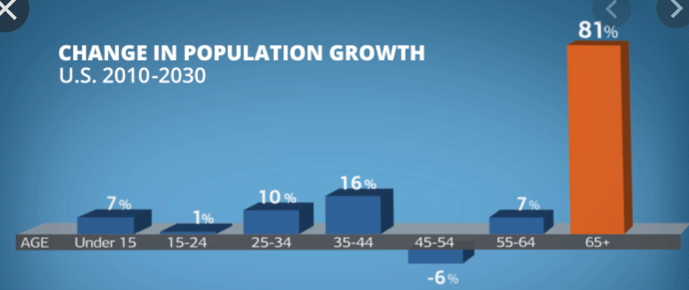
Application2 --Clinician In the Loop
“age wave”
Remote health monitoring and assessment
Notes:
In order to meet the health needs of the coming “age wave”, we want to design technology to support self-management and chronic conditions, even for individuals living in remote locations. For example, for people living in the rural area with limited healthcare services and resources, how could technology provide timely assistance to help them live in a healthier and better life.
In this study we design a clinician-in-the-loop visual interface, that provides clinicians with patient behavior patterns, derived from smart home data.

Slide 17
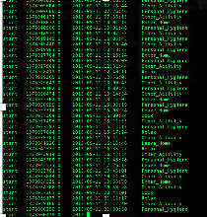
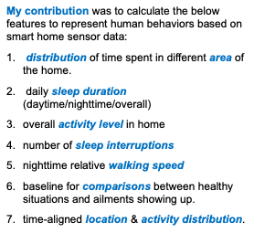
Methodology --Clinician In the Loop
Extract behavior markers from smart home data to support remote self-management
Design Behaviors Features
Schedule to
calculate features &
visualize
Notes:
(play the video of streaming sensor data)
Given the streaming sensor data, I designed methods to extract behavior markers from smart home data, including sleep interruptions, relative walking speed, and overall activity level. These markers support the creation of a visual interface for clinicians to use when interpreting resident health from sensor data.
Then the algorithm schedules a time to calculate those features everyday, and push the calculated results to a platform for vlisualization.

Slide 18
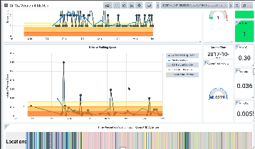
Impact --Clinician In the Loop
Extract behavior markers from smart home data to support remote self-management
Notes:
(play the video and point to the corresponding features) Here is the visualization. From this visualized interface, clinicians can use it to remotely monitor a smart home resident’s behaviors and provide timely assistance if necessary.
The new data mining techniques that I designed achieve competitive accuracies in capturing residents’ behavior. For example, the CIL project is capable of real time data processing, enabling interactive study of human behavior.
My collaboration with diverse domain experts was highlighted at different publications.
https://jbhi.embs.org/2019/07/01/medical-informatics-july-2019/

Slide 19
Step 2
Computational Challenges
in Sensor Data
Mathematic Model
of Behavior
Notes:
I developed efficient algorithms that utilize stochastic approaches and machine learning methods to express the nature of the observed behavior in smart homes.
2. focus on based on spatial and temporal features that extracted from smart home sensor data.
allows to us to investigate the complex dependencies of activities.
3. third, employ an IRL method to model indoor navigation and its behavior patterns by fuse two types of
features into one model.
When data are combined from multiple sources, a challenge arises in creating a model that can include all available information. The IRL method helps us construct a model that combines resident temporal and spatial information and also help us learn behavior preferences among population groups.
Note:
Each of these offers a different modeling benefit
???

Slide 20
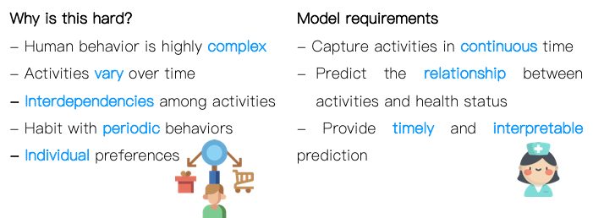
Formal Models of Indoor Behavior — Challenges
Notes:
People’s behavior varies and fluctuates due to numerous environmental and other factors.
In addition, the model needs to capture behaviors based on continuous time and predicts the relationship between behavior and health status.
I developed efficient models to capture behavior patterns and their variations for the purpose to express the nature of the observed behavior in smart homes.

Slide 21
Motivation --Formal Models of Indoor Behavior
Detect indoor behavior changes
Automatically recognize behavior patterns
Automatic diagnosis systems
Deliver effective healthcare interventions
Notes:
With our new ability to collect a massive amount of sensor data on subjects in an unobtrusive manner, we can now design data mining methods to better understand human behavior.
Researchers have been designing techniques for automatically recognizing activities in complex situations from scripted laboratory conditions to continuous real-world recognition. But a mechanistic description of models of indoor routine behavior patterns has not been explored. The results will offer the potential to detect indoor behavior changes within automatically recognized indoor behavior patterns. Based on the detection, automatic diagnosis systems can be developed to capture health ailments of an individual resident in order to deliver effective and timely health care interventions.

Slide 22
Formal Model 1 - Hypothesis
We hypothesize that:
We can mathematically model human behavior at an individual and population level based on ambient sensor data.
We first model temporal behavior features
We assume temporal behavior features can be:
activity durations, inter-arrival times of two successive activities, etc.
Notes:
We focus on inter-arrival times of successive activities

Slide 23



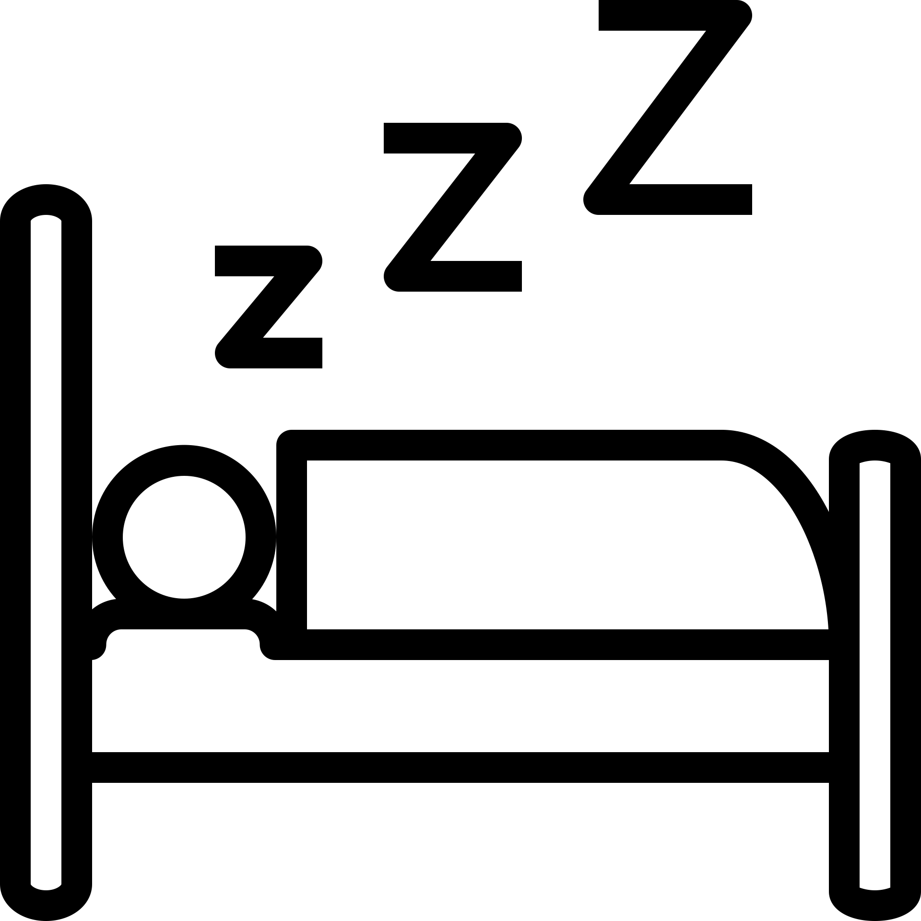
Mathematical Model of Indoor Behavior - Background
Inter-arrival times:
Cook
Eat
Personal Hygiene
Sleep
the time interval between two successive occurrences of activities
Notes:
Activities: we are looking at times between the “starts” of each activity occurrence.

Slide 24
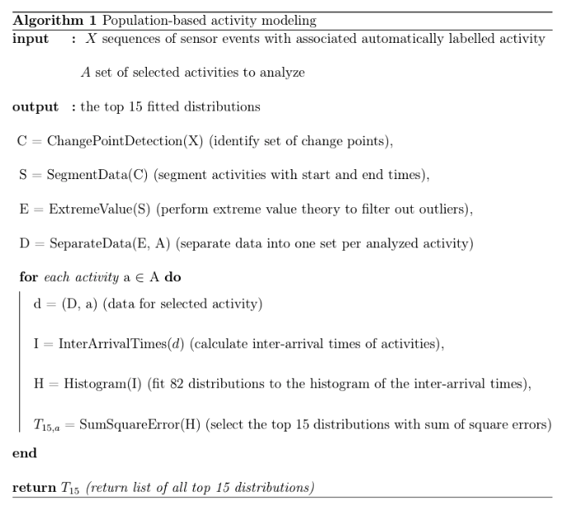
Formal Model 1 - Algorithm
Notes:
First, identify activity “starts”
Find activity transitions with CPD (when the process changes from one activity to another)
Segment the data based on these CPs (these create activity start/end points)
Clean data with EVT
Separate data (this is to perform experiments on large collection of data
========================================================================================
Here is the high level of the process.
At the high level, we use CPD, Segment, SVT.
Overleaf: Page 16

Slide 25
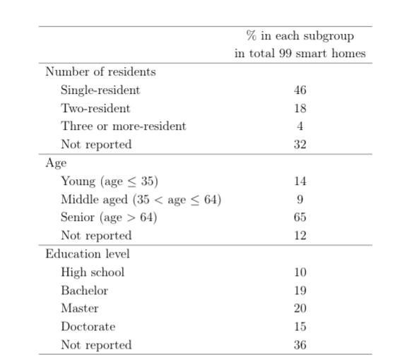
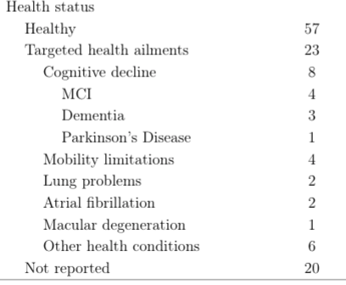
Model 1 - Datasets
Notes:
Three different data:
99 homes
Subgroups diagoised as healthy and with healthy conplaints
An individual started with healthy condition and developed congnitive declines.

Slide 26
Mathematical Model of Indoor Behavior - Experiments
Three experiments:
Population-wide analysis
99 homes selected subset of activities
2. Group-wide analysis on homes split into two groups
Healthy (57 homes) and Health complaints (23 homes)
Individual-based analysis on a single home with a more complete set of activities
An individual whose health condition is under watch
Notes:
A single home (hh103)

Slide 27
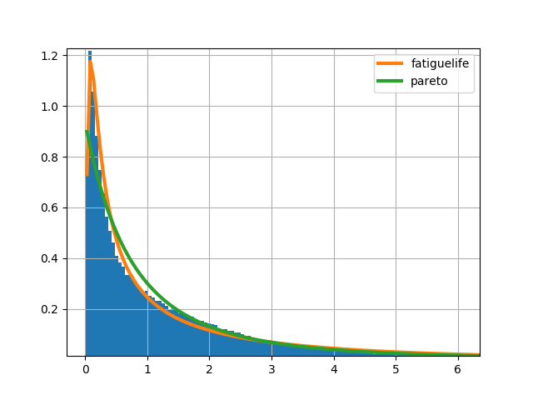
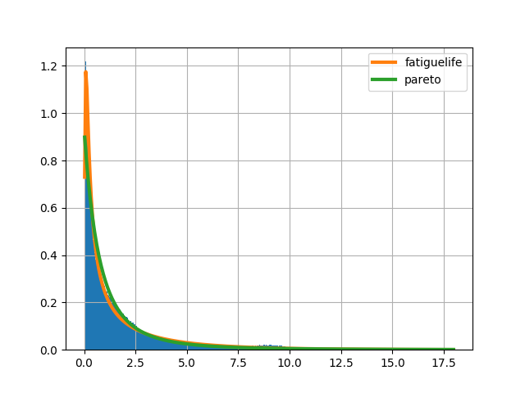
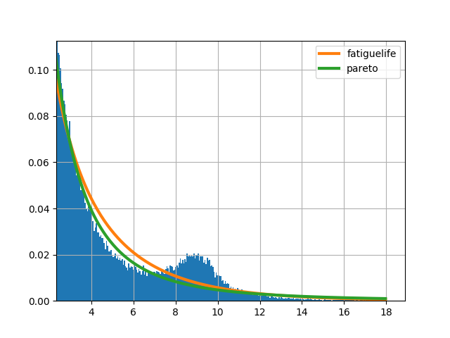
Results - Population-Wide Analysis
Frequency
Inter-Arrival Times of Person Hygiene (hours)
Notes:
Why Pareto fits well?
The Pareto distribution has the same order-of-magnitude errors (10-1) as the top distribution.
Pareto fits well
Pareto fits almost as well as top-fitting distribution, fatiguelife
Because it fits so well, we can use Pareto properties to describe this data
Pic: 99 homes (personal_hygiene). Location: icloud -> mini -> spring2018 -> Inter_Event_Time_Data_Experiments_All

Slide 28
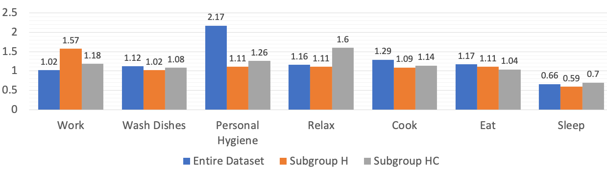
Results - Group-Wide Analysis
Subgroup H < Subgroup HC
The value of Pareto
shape parameter
Notes:
=======
values of the shape parameters of the Pareto distributions (small shape => heavier of the tail).
for the individual selected activities, the variations of which may be due to variations in health conditions. In the figure, we observe that the shape parameters for activities
Personal Hygiene, Relax, Cook, and Sleep in Subgroup H < the shape parameters in Subgroup HC. possibly due to fewer interruptions.

Slide 29
Results - Single-Person Analysis
Shape Parameter of the Pareto distribution: 1.17
Scale parameters: 0.29
comprises 80% of the total inter-arrival hours
17% of the total number of inter-arrival points,
occurs in the tail
Notes:
also fits the inter-arrival times for all routine activities.
Same order of magnitude errors.
The shape parameter of the inter-arrival times of all activities is 1.17.
Given the values of the shape and scale parameters, we confirm that 17% of the total number of inter-arrival points, which occurs in the tail, comprises 80% of the total inter-arrival hours.
To further investigate the relationship between the fat tail of the Pareto distribution and the resident’s health status, we first look at the 20% of inter-arrival times that occur in the tail.
(20% of the total number of inter-arrival points, comprises 74% of the total inter-arrival hours. )

Slide 30
Results - Single-Person Analysis
((Personal_Hygiene <=> Enter_Home)
(Leave_Home <=> Personal_Hygiene)
(Personal_Hygiene <=> Bed_Toilet_Transition)
Notes:
We notice that the successive activities, Sleep and Bed-Toilet Transition, occur in 40% of the cases lying in the tail.
The datapoints, inter-arrival times of two activities, in the tail represents the large gap between two successive activities. The figure shows the of the tail investigation.

Slide 31
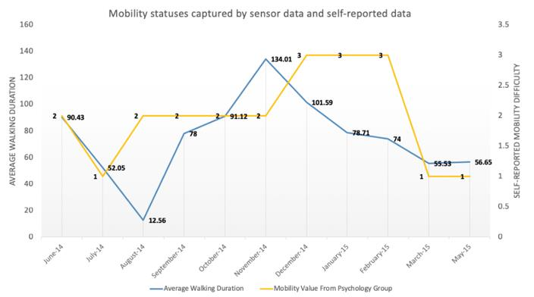
Impact --Formal Models of Indoor Behavior
The trend of a resident’s mobility difficulty
Notes:
Here is our captured information.
Point to the graph: we can see that when the mobility difficulty increases, which is the yellow line, the average duration of walking from bed to toilet also increases, which is the blue line.
A greater understanding of human routine behavior and its variations can transform how healthcare services are delivered to millions of homes.

Slide 32
Mathematical Model of Indoor Behavior – Conclusions
Indoor behavior can be formally modeled by many standard distributions
Pareto distribution fits many activity inter-arrival times
Thus we can use 80/20 rule to describe properties of the observed behavior
Notes:
1. thus providing unique insights into behavior norms for the entire sampled population and behavior variations between population subgroups.
2.

Slide 33
Contributions
Indoor behavior can be modeled by a Pareto distribution
Innovation: heavy-tailed distribution (Pareto distribution)
Impact: the Pareto distribution and its properties, the 80/20 rule, can be used to model various human behavior patterns

Slide 34
Formal Model 2
Stochastic approaches to study behavior random walks on Markov chains (MC)
Cognitive Decline
Behaviors are
Random
or
Markovian
What is Markov Models?
Notes:
While working with nurses, we want to to answer the question that when residents’ cognitive ability declines, whether their behavior is random or Markovian. For example, when people developed dementia, their behavior may be more random.

Slide 35
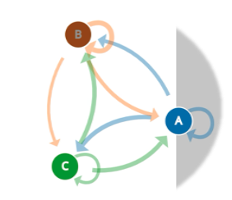
Formal Model 2 -- Background
Markov Chains
Lin, B., Cook, D., and Roy, S., 2021. Markov Models of Human Indoor Behavior, Journal of Biomedical and Health Informatics (to submit).
Notes:
What is Markov model? (play the gif) and explain.
For example, 1st order MC means the next event only depends on the current event (such as A only depends on B). 2nd order MC means the next event depends on the past two events (such as A depends on B and C).
We want to model the behavior among different subgroups (such as seniors with and without cognitive impairment, young resident, middle aged residents) and study the difference among those models. Thus, we can predict an individual features within a group and notice as early as possible when a person starts having health ailments, such as cognitive decline.

Slide 36
Markov Model of Indoor Behavior - Hypothesis
1. Examine the question of whether a person’s indoor activities are Markovian.
2. Identify the Markov order that best fits behavior-driven sensor data.
3. Select the orders of Markov models that best capture resident activities.
4. Perform this process on different population subgroups.
(health status on formal models of human behavior)

Slide 37
Markov Model of Indoor Behavior – Markovian
Inter-arrival times of indoor activities can be described by Pareto distribution
2. A Pareto distribution is a special case of Lévy flight
3. A Lévy flight is a Markovian stochastic process
indoor resident behavior captured by sensors is a Markov process
Notes:
To determine the order, we first see if human behavior is Markovian
In the previous study, we conclude that the inter-arrival times of indoor activities can be described by Pareto distribution, a special case of Lévy flight [104] that is a Markovian stochastic process. Thus, indoor resident behavior captured by sensors is a Markov process.
Now, we select Markov models that best described resident activities.

Slide 38
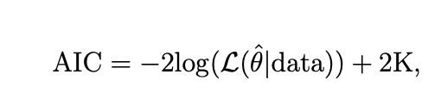
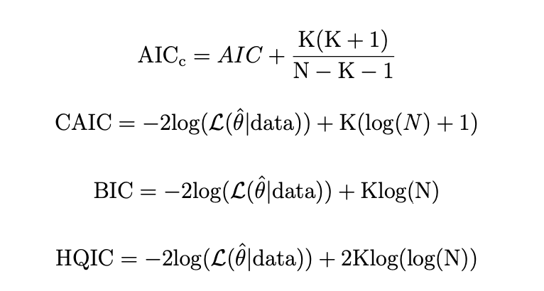
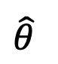
Markov Model of Indoor Behavior – Order Selection
Current measures
: maximum likelihood estimate
: likelihood of the model
: # of model parameters
$\hat{θ}$
Good if N/K < 40
: sample size
Notes:
AIC: Each measure has two parts: the likelihood and the penalty.
dimensional inconsistency: N -> infinity, the probability of selecting a correct modeling using AIC does not approach 1.
overestimate: prefer complex models (higher-orders).
To overcome those problems, other measures were proposed to include a sample size in the penalty. However, those measures prefer simple models (lower-order Markov chains). AIC_c works for small dataset (N/K < 40), since our smart home dataset is large, we do not consider in our study.
For CAIC, as we can see, the only difference is the K (number of parameters). When N goes large, the impact of a single K would be small. That is, the results of CAIC would be similar as BIC. So we do not consider CAIC here.
Thus, we test the performance of AIC, BIC, HQIC.

Slide 39
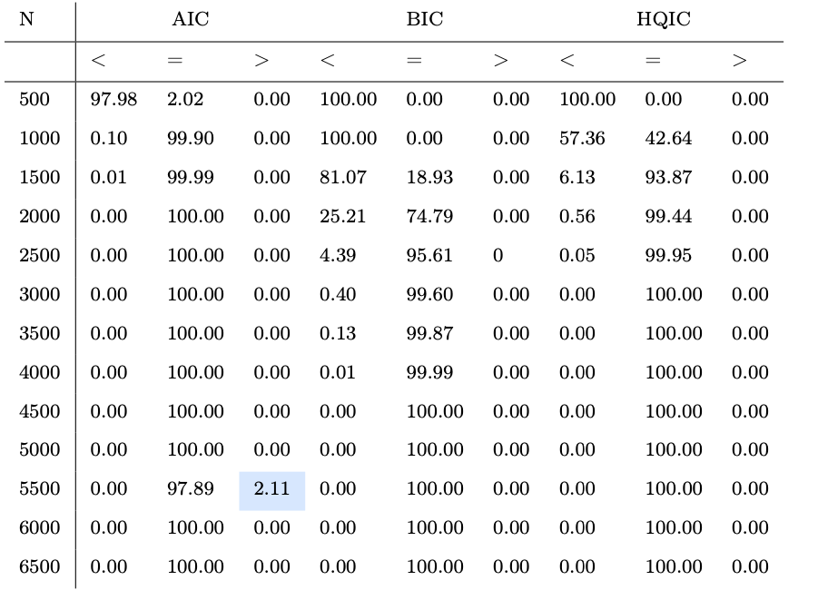
Markov Model of Indoor Behavior – Order Selection
under-estimate
Current measures
0.00
over-estimate
Notes:
The percentages of correctly choosing the orders given nine states first order Markov chains.
These are based on synthetic data generated by a Markov chain with a known order (e.g., 1st order).
N: sample size
< : under-estimate (the selected order is lower than the given order of a Markov chain).
= : correctly estimate the order of Markov chains
> : over-estimate (the selected order is higher than the given order of a Markov chain).

Slide 40
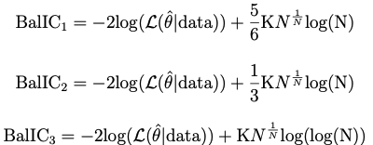
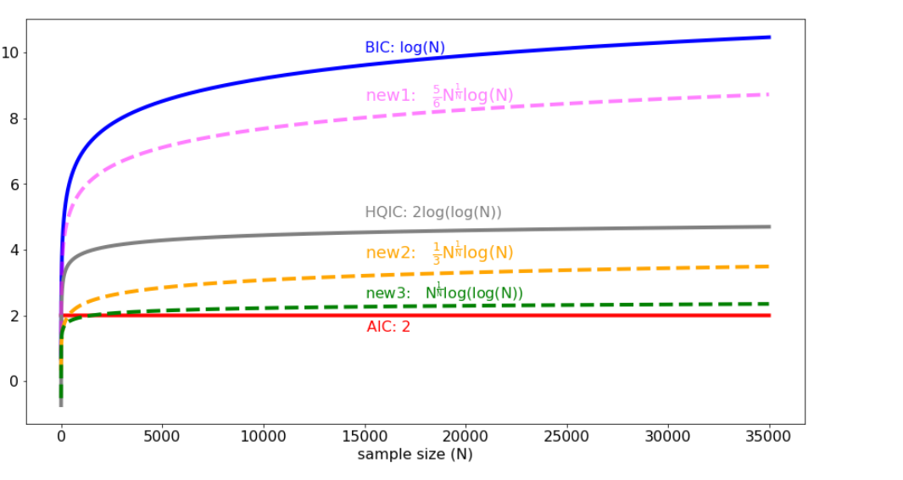
New Measure: BalIC (Balanced Information Criteria)
Value of penalty
BalIC1:
BalIC2:
BalIC3:

Slide 41
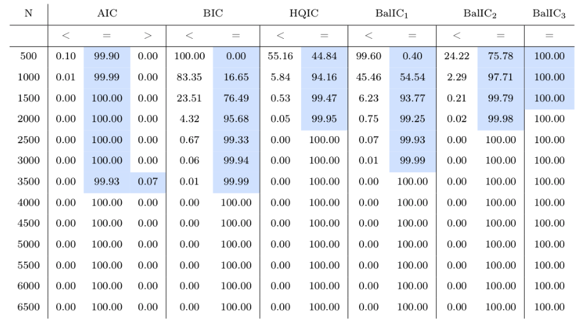
Performance of Current and New Measures
over-estimate
under-estimate
good
Notes:
we would favor BalIC2 and BalIC3 to select the order of Markov chains. Both measures perform better than AIC, BIC, and HQIC.
However, for small sample sizes BalIC2 still demonstrates underestimating problems. Therefore, we choose BalIC3 as a new measure to select the order of Markov chains.

Slide 42
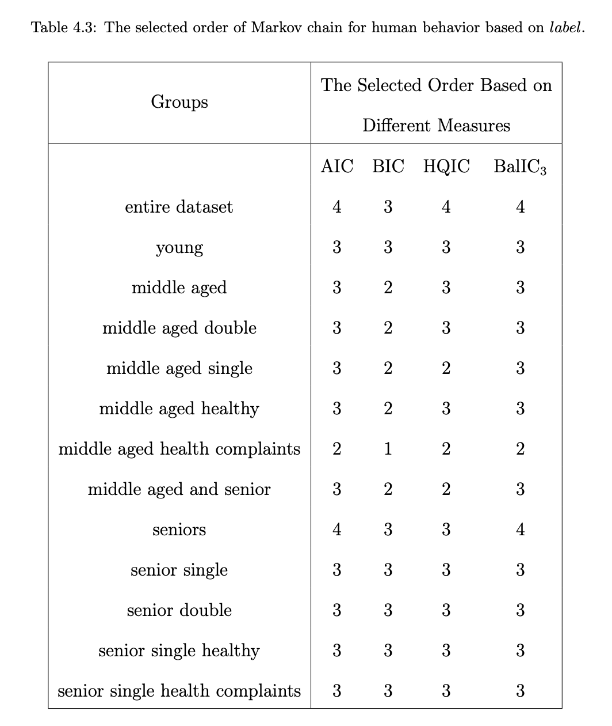
Markov Model of Indoor Behavior – Smart Home Data
2011-06-13 10:23:15.231817 Kitchen OFF Wash_Dishes
2011-06-13 10:23:16.156653 Kitchen ON Wash_Dishes
2011-06-13 10:23:17.277543 Kitchen OFF Wash_Dishes
2011-06-13 10:23:17.804728 Kitchen ON Wash_Dishes
2011-06-13 10:23:18.459437 Kitchen ON Cook
2011-06-13 10:23:19.612122 Kitchen OFF Cook
2011-06-13 10:23:19.739553 Kitchen OFF Cook
2011-06-13 10:23:20.253069 Kitchen ON Cook
Notes:
people with cognitive decline may forget the more structured behavior
This table lists the selected orders of Markov models for different population groups based on the smart home sensor data as listed on the left side.
The best-fit order of Markov chains for the seniors population subgroup is the same as the selected order for the entire data set.
This makes sense since 66% of the residents are seniors in our experiments.
Interestingly, the group middle aged with health complaints exhibits a lower order than the other groups.
1. Lower-order models do not rely on as many previous states to predict the next state.
2. They can be interpreted as simpler models, with less structure.
3. One possible explanation for this observation is that middle-aged individuals have more obligations and their schedule might be
more highly variable.
4. the health complaints of middle-aged residents (e.g. dementia and MCI) may contribute to the lower order of Markov chains, since people with cognitive decline may forget the more structured behavior

Slide 43
Markov Model of Indoor Behavior – Conclusions
Our new measure, BalIC₃ , outperforms the others
dimension consistency
no under-estimating problem based on the experiments’ results
Human behavior can be expressed with a Markov chain (it is Markovian)
Markov chain orders (and thus the observed human behavior complexity) depend on the nature of the sensor data and its level of detail
Notes:
4: (see details of additional experiments in dissertation) -- state this orally
Note: 4: The more- complex nature of this data indicates more complicated dependence relationships within the sequence, and a higher-order Markov chain describes this complicated property .

Slide 44
Contributions
Indoor behavior can be modeled by a Pareto distribution
Innovation: heavy-tailed distribution (Pareto distribution)
Impact: the Pareto distribution and its properties, the 80/20 rule, can be used to model various human behavior patterns
2. Proposed a new measure for model selection
Innovation: a new measure to balance the tradeoff between under/over-estimating the true Markov order
Impact: understand the complexity of sensor-observed human indoor behavior

Slide 45
Step 3
Computational Challenges
in Sensor Data
Mathematic Model
of Behavior
Inverse Reinforcement Learning
Model of Behavior

Slide 46
Inverse Reinforcement Learning (IRL) of Indoor Behavior - Hypothesis
1. Model navigation patterns as a Markov decision process
2. Design the spatio-temporal features of indoor navigations
3. Learn a behavior strategy that is consistent with the observed movement patterns
4. Analyze behavior patterns and differences on different subgroups (eight actual smart homes)
What is reinforcement learning?
Lin, B. and Cook, D.J., 2020. Analyzing Sensor-Based Individual and Population Behavior Patterns via Inverse Reinforcement Learning. Sensors, 20(18), p.5207.

Slide 47
Background
Reinforcement Learning
Notes:
Give positive reward or negative reward.
For the previous example, given an apple, the robot thinks it’s an apple, then the robot will get the positive reward.
the robot thinks it’s an orange, then the robot will get the negative reward.

Slide 48
Inverse Reinforcement Learning (IRL) of Indoor Behavior – RL v.s. IRL
Notes:
Unlike other IRL research, which learns from imitation to recreate expert moves, we learn from mimicry to capture and analyze a model of human behavior.
To model human behavior from ambient sensor data, we propose an approach that is based on inverse reinforcement learning (IRL).
IRL is a machine learning technique that mimics observed behavior. In this study, our proposed algorithm mimics the behavior of a smart home resident based on sensor-observed navigation patterns within a home environment.
Unlike other IRL research, which learns from imitation to recreate expert moves, we learn from mimicry to capture and analyze a model of human behavior.
Note: the significance of learning the rewards: learn the preference differences on different subgroups.

Slide 49
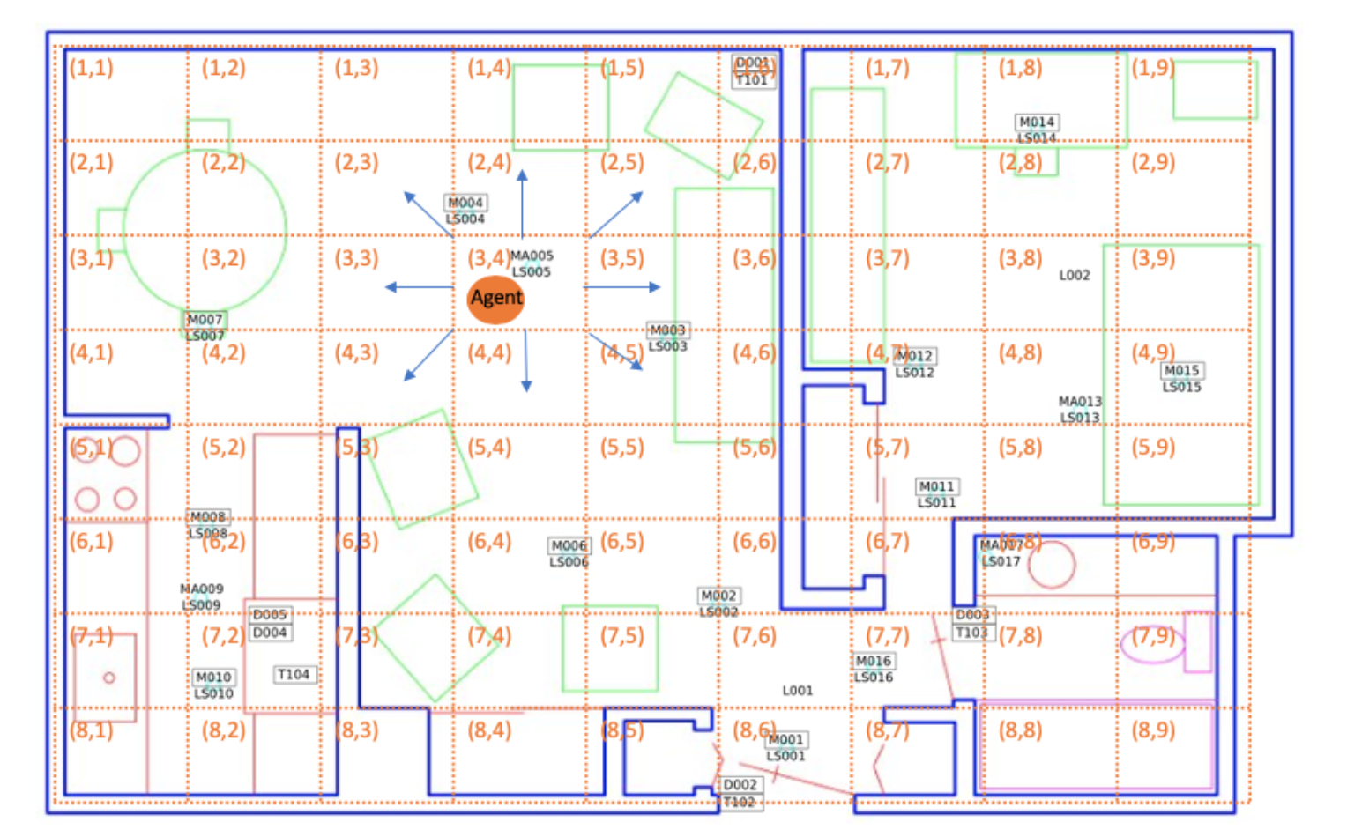
Inverse Reinforcement Learning (IRL) of Indoor Behavior – Navigation
d_toilet | d_bathroom_sink | d_livingroom_chair | d_kitchen_sink
d_bedroom | d_kitchen | d_livingroom | d_hallway
d_stove | d_office_chair | o_toilet | o_livingroom_chair
o_kitchen_sink | o_office_chair
Notes:
Table is the features:
feature names prefixed by “d : the duration that the resident stays at a location
feature names prefixed by “o_”: the overall activity/movement level at a location

Slide 50
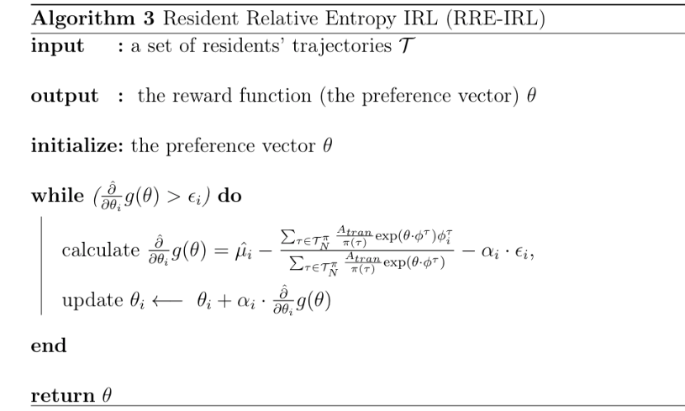
Inverse Reinforcement Learning (IRL) of Indoor Behavior – Algorithm
:
Notes:
IRL is an optimization problem. To solve it, there are two steps:
1. introducing Lagrange multipliers to have a Lagrangian
2. solving a Lagrange dual function g
Note: \hat{\partial} g(\theta) is the gradient of the dual function g.
\hat{\partial} g(\theta) : gradient estimation based on trajectories.
1. \hat{u_i}: feature expectations
2. A_tran: join probability of the actions executed on the states in trajectories.

Slide 51
Inverse Reinforcement Learning (IRL) of Indoor Behavior – Datasets
Group | ID | Health Diagnosis | #Sensors | Duration of Data Collection | Number of Month-long Samples
Cognitive decline | Home 1 | Mild Cognitive Impairment (MCI) | 21 downward-facing motion (motion); 2 motion area (ma) | 843 days | 26
 | Home 2 | MCI | 19 motion; 2 ma | 223 days | 7
 | Home 3 | MCI | 26 motion; 0 ma | 682 days | 22
 | Home 4 | MCI, Early dementia | 11 motion; 2 ma | 149 days | 5
Cognitively healthy | Home 5 | Healthy | 13 motion; 1 temperature | 1788 days | 56
 | Home 6 | Healthy | 13 motion | 1591 days | 49
 | Home 7 | Healthy | 18 motion; 2 ma | 379 days | 12
 | Home 8 | Healthy | 10 motion; 1 ma | 969 days | 31
Notes:
Talk about the purposes of the experiments. What we hope IRL is doing and what we hope to find?
We analyze movement-based behavior data collected in 8 smart homes. The table provides a summary of the eight homes.
To facilitate comparative analysis between population sub-groups, we selected four homes with
1. four homes with older adult residents who are experiencing cognitive decline.
2. older adult residents who are diagnosed as cognitively healthy

Slide 52
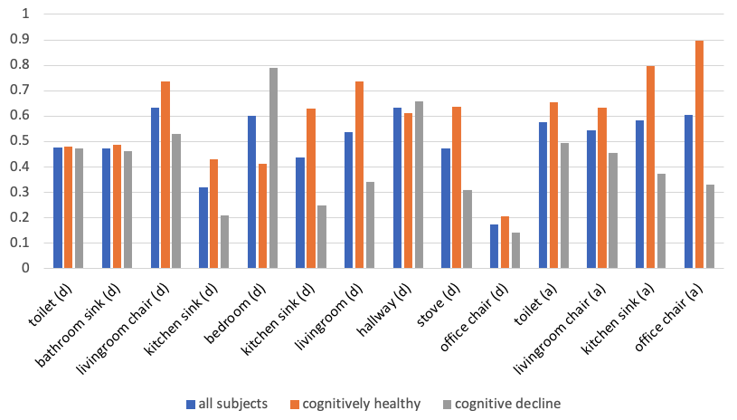
Inverse Reinforcement Learning (IRL) of Indoor Behavior – Results
preferences of all subjects
most great differences between two subgroups
less preferences of all subjects
Lin, B. and Cook, D.J., 2020. Analyzing Sensor-Based Individual and Population Behavior Patterns via Inverse Reinforcement Learning. Sensors, 20(18), p.5207.
Notes:
talk about the purpose of the experiments??
learned preference values of each feature
The figure shows preference values for all subjects, cognitively healthy and those with cognitive decline learned using the RRE-IRL algorithm.
Overall, the subjects, all of whom are older adults, show a preference for time spent in a favorite living room chair and in the hallway transitioning between regions of the home.
Much less of an influence on their routine is time spent in the office chair or at the kitchen sink.
The two population subgroups, cognitively healthy and cognitive decline, differ most greatly in terms of time spent
in the bedroom
at the kitchen sink and stove,
in the living room.
Subjects with cognitive decline show stronger preference for time in the bedroom, while cognitively healthy subjects exhibited preference for time in the living room and kitchen. Additionally, cognitively healthy subjects showed a stronger preference for overall activity in area of the monitored areas.

Slide 53
Inverse Reinforcement Learning (IRL) of Indoor Behavior – Conclusions
1. Indoor navigation can be described as a Markov decision process
2. Spatial and temporal features can be fused into one model
3. Indoor behavior strategy can be learned via IRL
4. Cognitively declined residents can be distinguished from healthy population

Slide 54
Contributions
Indoor behavior can be modeled by a Pareto distribution
Innovation: heavy-tailed distribution (Pareto distribution)
Impact: the Pareto distribution and its properties, the 80/20 rule, can be used to model various human behavior patterns
2. Proposed a new measure for model selection
Innovation: a new measure to balance the tradeoff between under/over-estimating the true Markov order
Impact: understand the complexity of sensor-observed human indoor behavior
3. Proposed inverse reinforcement learning to learn indoor behavior
Innovation: 1st study of IRL to model indoor behavior
Impact: extract quantitative and qualitative measures of human behavior
4. Distinguished population subgroups based on ambient sensor data
Innovation: population-level behavior analysis via ambient sensor data
Impact: compare behavior for healthy older adults with behavior of older adults with chronic health conditions

Slide 55
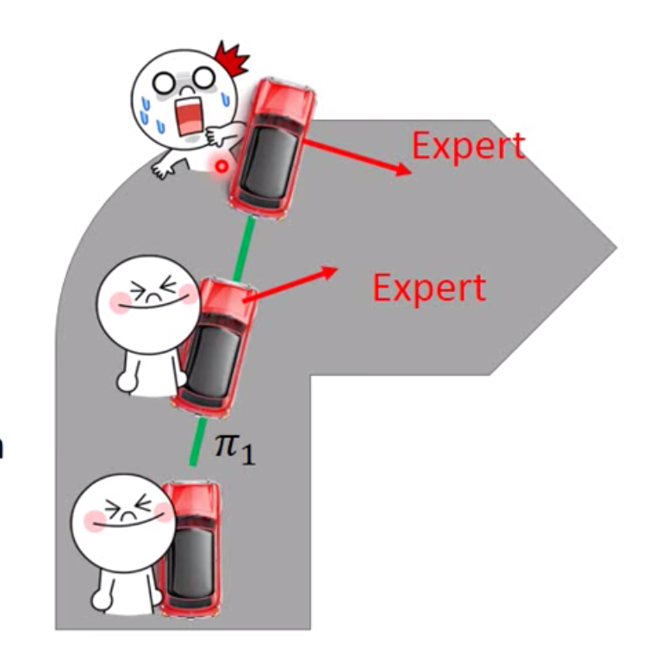
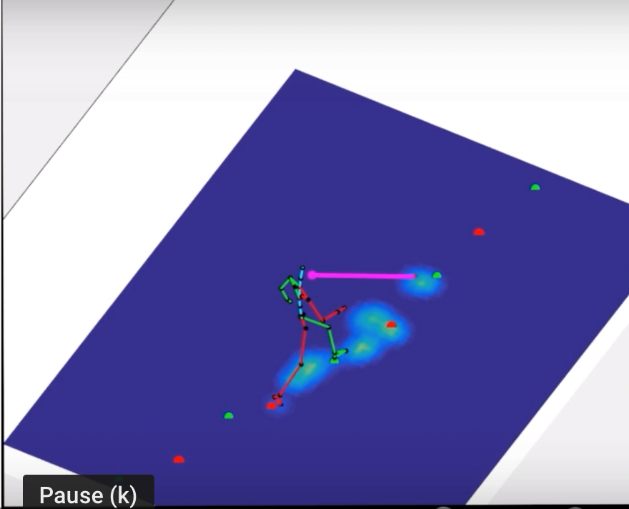
Research Vision
Extend current work of smart home
Develop models include sufficient information of behavior fluctuations
(e.g., IRL, adversarial IRL, and generative adversarial imitation learning)
Investigate temporal and spatial properties in transfer learning scenarios.
Mining rare behavior
Propose a new framework for rare behavior detection
Combine ideas from both adversarial training and classification
Model ICU patient’s behavior
Patients’ mobility patterns
ICU instruments’ data (time series data)
Notes:
Research:
I’d be excited to further extend current work of behavior modeling and develop models that include sufficient information of behavior fluctuations.
For example, models include temporal and spatial properties. We can also develop the temporal transition structures of activities and further explore the relationship between behavior and spatial autocorrelations.
My next goal is to design methods to infer a reward function from a resident’s in-home trajectory during the time s/he is healthy, and then use deviations from this learned function to predict abnormal behavior which may indicate potential health problems.
# For example, residents who make changes in their routine, such as sleeping in a living room recliner rather than a bed, are due to their health problems/ deterioration, such as increasing breathing difficulties.
——- Another interesting topic is mining rare behavior among seniors (e.g., falls) which results in major public health problems (e.g., increased morbidity, mortality, and healthcare costs). But due to extremely low prevalence of rare behavior, they are hard to detect. How do we reliably detect rare behavior given such a low prevalence? How to further leverage resident’s rare behavior for possible health problems? This study will focus on proposing a new framework for rare behavior detection that generates samples and combines ideas from both adversarial training and classification (GAN).
——
Looking further out, I plan to model ICU patient’s behavior, including studying patients’ mobility patterns based on computer vision methods and analyzing and modeling ICU instruments’ data (i.e., time series data). Modeling ICU patient’s behavior would help understand and predict the development of an illness or the recovery from health problems. The findings would assist clinicians to make better decisions.
——
Add future collaboration in each department. Specific lab and people.

Slide 56
Thank you!
Notes:
Research:
I’d be excited to further extend current work of smart home and develop models that include sufficient information of behavior fluctuations. For example, models include temporal and spatial properties.
My next goal is to design methods to infer a reward function from a resident’s in-home trajectory during the time s/he is healthy, and then use deviations from this learned function to predict abnormal behavior which may indicate potential health problems.
# For example, residents who make changes in their routine, such as sleeping in a living room recliner rather than a bed, are due to their health problems/ deterioration, such as increasing breathing difficulties.
We can also adopt computer vision methods to study resident’s gait and mobility difficulty. Also can apply RL or IRL methods to the field of self driving cars.
A greater understanding of human routine behavior and its variations can transform how healthcare services are delivered to millions of homes.
Teaching:
I would be happy to teach undergraduate and graduate classes in data mining, machine learning or artificial intelligence, in addition to undergraduate courses in many other topics, including data structures and algorithms.
I am also interested in developing an advanced level course about data mining in pervasive computing.
I will focus on how to translate series of “raw” data in high-level knowledge by both algorithms (e.g. machine learning, statistics, and mathematical modeling) and perspectives from domain experts (psychologist, clinicians, and nurses).

